Slide 1

Credit Card Fraud Detection Website Using Machine Learning Guide: Dr. Harsh Pratap Singh
Presented by:
Aaditya Anand (EN19CS301004)
Abhay Singh Chauhan (EN19CS301011)
Advait Patidar (EN19CS301027)

Slide 2
Overview about the project
Introduction to Credit Card Fraud Detection
System Requirement Specifications
System Analysis & Design
Implementation
Result & Discussion
Summary & Conclusion
Future Scope

Slide 3
Introduction
As the payment method is simplified by the combination of the financial industry and IT technology, the payment method of the consumers is changing from cash payment to electronic payment using a credit card, mobile micropayment, and app card.
As a result, the number of cases in which anomalous transactions are attempted by abusing e-banking has increased and financial companies started establishing a Fraud Detection System (FDS) to protect consumers from abnormal transactions.
The abnormal transaction detection system aims to identify abnormal transactions with high accuracy by analyzing user information and payment information in real-time.
In this project, we will investigate the trend of abnormal transaction detection using payment log analysis and data mining and summarize the data mining algorithm used for abnormal credit card transaction detection. We will use python programming for advanced processing of data and high accuracy.

Slide 4
Objectives of Credit Card Fraud Detection
There is a substantial rise in some technologies like “machine learning, artificial intelligence, deep learning” and other relevant fields of information technology. These technologies help us automate the credit card fraud classification process.
The key objective of the Credit card Fraud Detection Website is to improvise the procedure of personal follow-up on many suspicious transactions.
To discover a path to preprocess the flagged records to recognize the probable genuine entries from the list of genuine/falsified entries.
Here, the volume of needless analysis is decreased leading to significant savings for the financial institutions. Moreover, the current FDS threshold can also be lowered and several fraudulent cases, being missed under this level, can be detected.
The system will overcome the low accuracy forecast problems, utilize the latest AI methods, reduce false alerts, recognize fraudulent transactions, and attain fast and reliable solutions.

Slide 5
Methodology
The performance of fraud detection in credit card transactions is greatly affected by the sampling approach on the dataset, selection of variables, and detection technique(s) used. The Credit Card Fraud Detection Problem includes modeling past credit card transactions with the knowledge of the ones that turned out to be a fraud. Hence, we are using the technique of machine learning for fraud detection. In this, we take the real bank dataset and split the dataset into a training set and testing set, and then apply the Logistic Regression method.
Reading the dataset from the file “creditcard.csv” which has 2,84,807 transactions. To get all variables in an equivalent range, we subtract the mean and divide it by the standard deviation such that the distribution of the values is normalized.
Then we perform normalization. To get all variables in an equivalent range, we will subtract the mean and divide it by the standard deviation such that the distribution of the values is normalized.
The plotting of the dataset is done. We will first define some models like the “Logistic Regression, Gaussian Naïve-Bayes, and Decision Tree Classifier”, and then loop through a training and testing set. First, we will train the model with the training set and then validate the results with the testing set.

Slide 6
Issues with the Initial System
In existing System, research about a case study involving credit card fraud detection, where data normalization is applied before Cluster Analysis and with results obtained from the use of Cluster Analysis and Artificial Neural Networks on fraud detection has shown that by clustering attributes neuronal inputs can be minimized.
And promising results can be obtained by using normalized data and data should be MLP trained. This research was based on unsupervised learning.
The data set for this research was based on real life transactional data by a large European company and personal details in data is kept confidential. Accuracy of the algorithm is around 50%. Significance of this research was to find an algorithm and to reduce the cost measure. The result obtained was by 23% and the algorithm they find was Bayes minimum risk.

Slide 7
Proposed System and its advantages
In proposed System, we are applying Random Forest algorithm, Bernoulli Naive Bayes Model and Logistic Regression algorithm for classification of the credit card dataset.
A subset of the training set is sampled randomly so that to train each individual tree and then a decision tree is built, each node then splits on a feature selected from a random subset of the full feature set.
We propose a Machine learning model to detect fraudulent credit card activities in online financial transactions. Analyzing fake transactions manually is impracticable due to vast amounts of data and its complexity. However, adequately given informative features, could make it is possible using Machine Learning. To classify fraudulent and legitimate credit card transaction by supervised learning Algorithm such as Logistic Regression.
The 'amount' feature is the transaction amount. Feature 'class' is the target class for the binary classification, and it takes value 1 for positive case (fraud) and 0 for negative case (not fraud).

Slide 8
Functional Requirements
Pre-processed Data: Data Preprocessing is a technique that is used to convert the raw data into a clean data set. In other words, whenever the data is gathered from different sources it is collected in raw format which is not feasible for the analysis. Therefore, certain steps are executed to convert the data into a small clean data set.
Training and Testing Data: The data we use is usually split into training data and test data. The training set contains a known output, and the model learns on this data to be generalized to other data later on. We have the test dataset (or subset) to test our model’s prediction on this subset.
Model Creation: The process of training an ML model involves providing an ML algorithm (that is, the learning algorithm) with training data to learn from. The learning algorithm finds patterns in the training data that map the input data attributes to the target (the answer that you want to predict), and it outputs an ML model that captures these patterns.

Slide 9
Non -Functional Requirements
Efficiency in Computation: While the model is executing, the software shall utilize less system’s CPU resource and very little of system memory.
Extensibility: The software shall be extensible to support future developments and add-ons.
Portability: The Credit Card Fraud Detection website should be portable to all operating platforms.
Performance: The software shall minimize the number of calculations needed to perform image processing and hand gesture detection.
Reliability: The software shall be operable in all conditions.

Slide 10
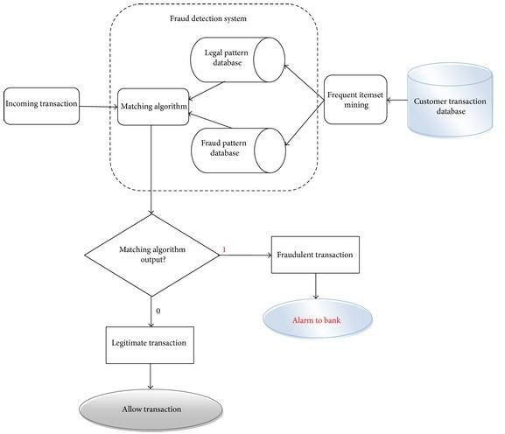
Data Flow Diagram

Slide 11
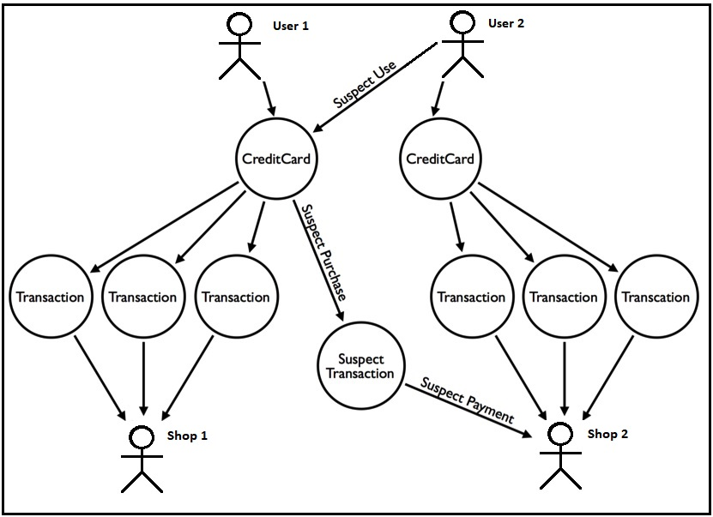
Use Case Diagram

Slide 12
Procedural Description
First, we obtained our dataset from Kaggle, a data analysis website which provides datasets. Inside this dataset, there are 31 columns out of which 28 are named as v1-v28 to protect sensitive data.
The other columns represent Time, Amount and Class. Time shows the time gap between the first transaction and the following one. Amount is the amount of money transacted.
Class 0 represents a valid transaction and 1 represents a fraudulent one.

Slide 13
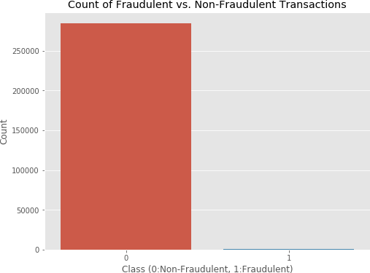
Balancing data Since the data is very imbalanced, we will be using some Under sampling and Oversampling techniques. As the name suggests, under sampling to reduce the samples from majority class and Oversampling is used to increase the samples from minority class.
Now, even though almost all the features are dimensionally reduced using some dimensionality reduction technique, two of the features are in their original form. Time and Amount are the two features which we will be scaling to make our model learn features correctly. Splitting the data now, since we needed to save some entries from the data for our testing purpose, we will now be splitting the data into two parts, namely, train and test.

Slide 14
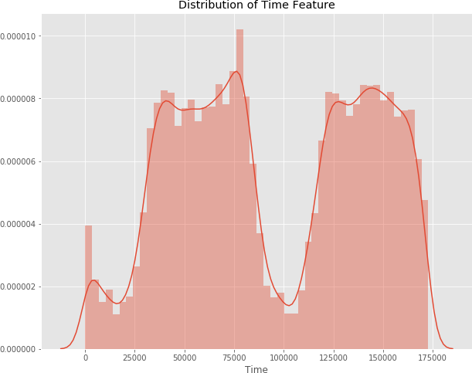
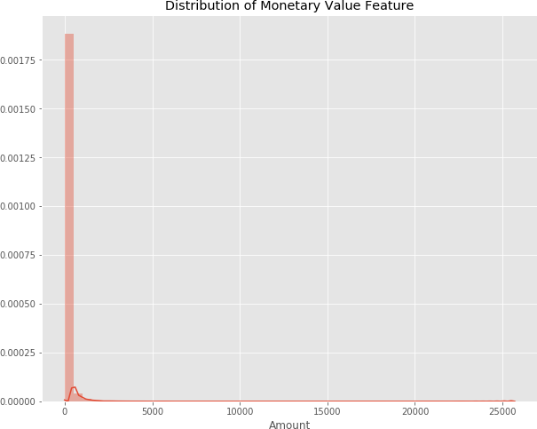

Slide 15
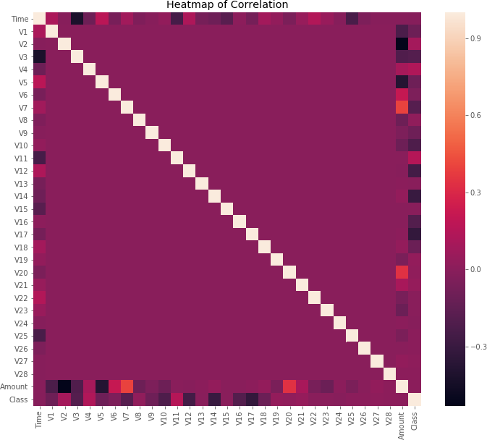
After this analysis, we plot a heatmap to get a colored representation of the data and to study the correlation between out predicting variables and the class variable. This heatmap is shown below:

Slide 16
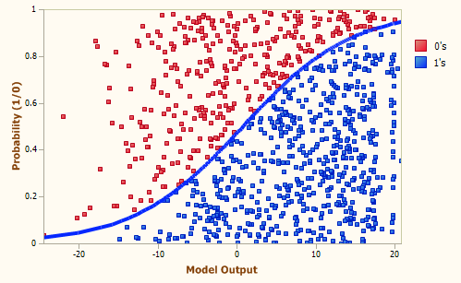
Module Description
We used Logistic Regression classifier for the project. A logistic regression model is used to predict the probability of a certain class or event existing. We then decide the class from which the entry belongs by using a threshold value. This threshold value is decided by manipulating the Precision-Recall tradeoff.

Slide 17
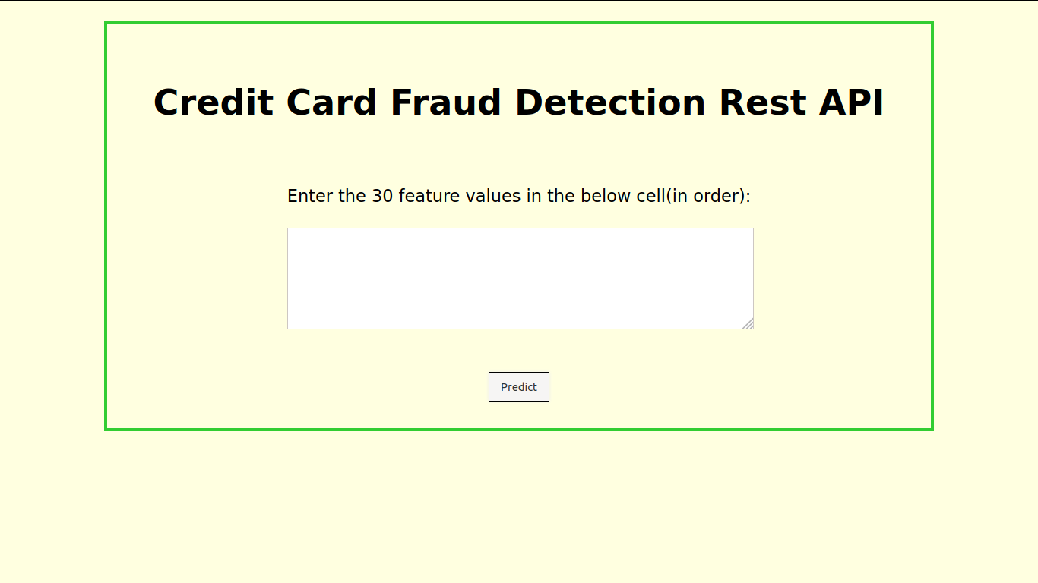
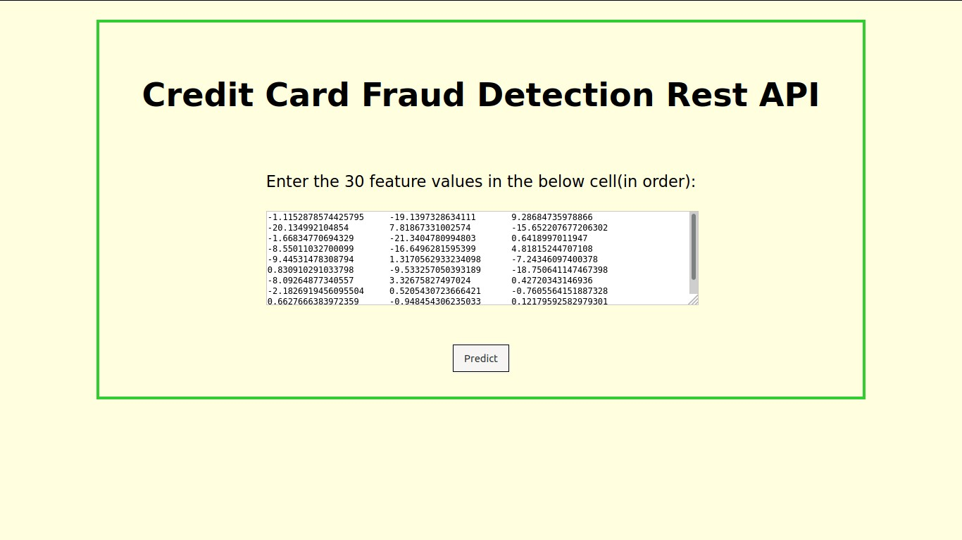
Sneak Peak into the Web - Application

Slide 18
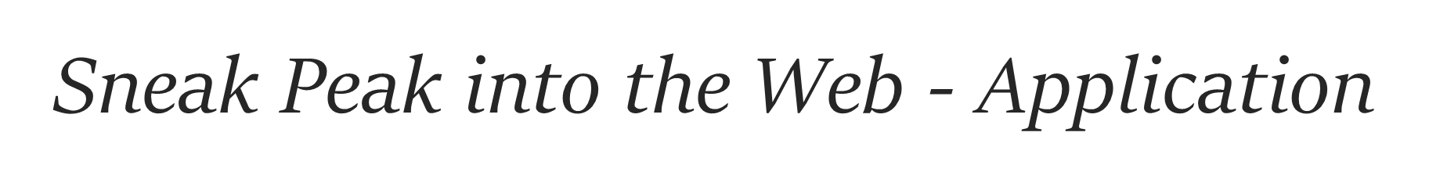
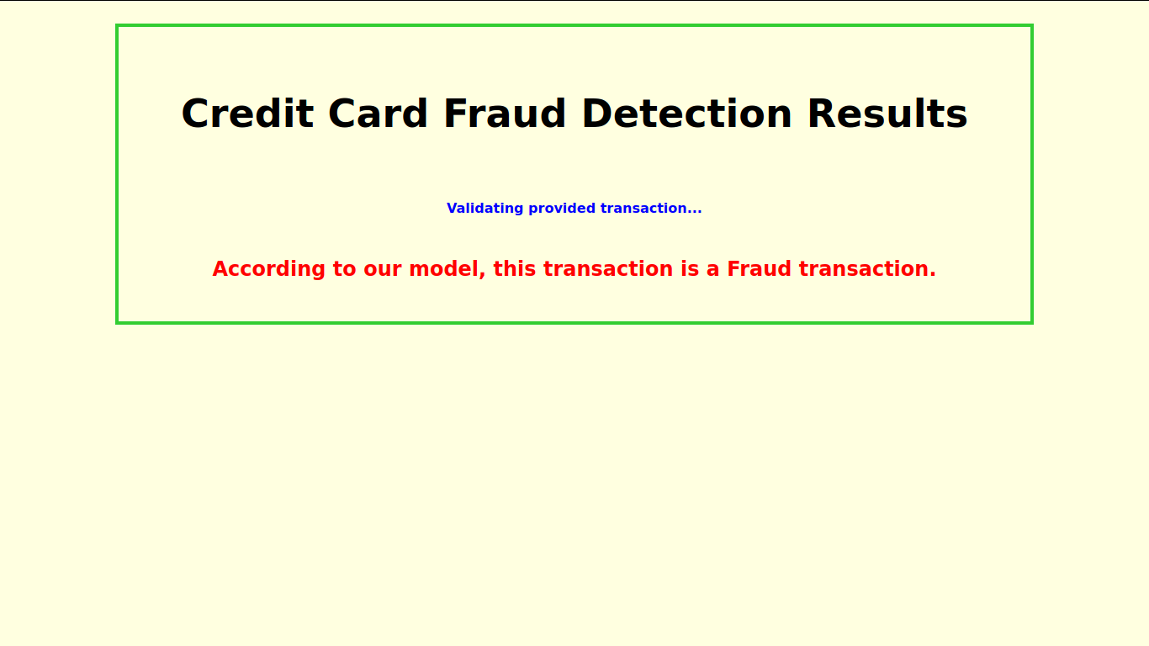
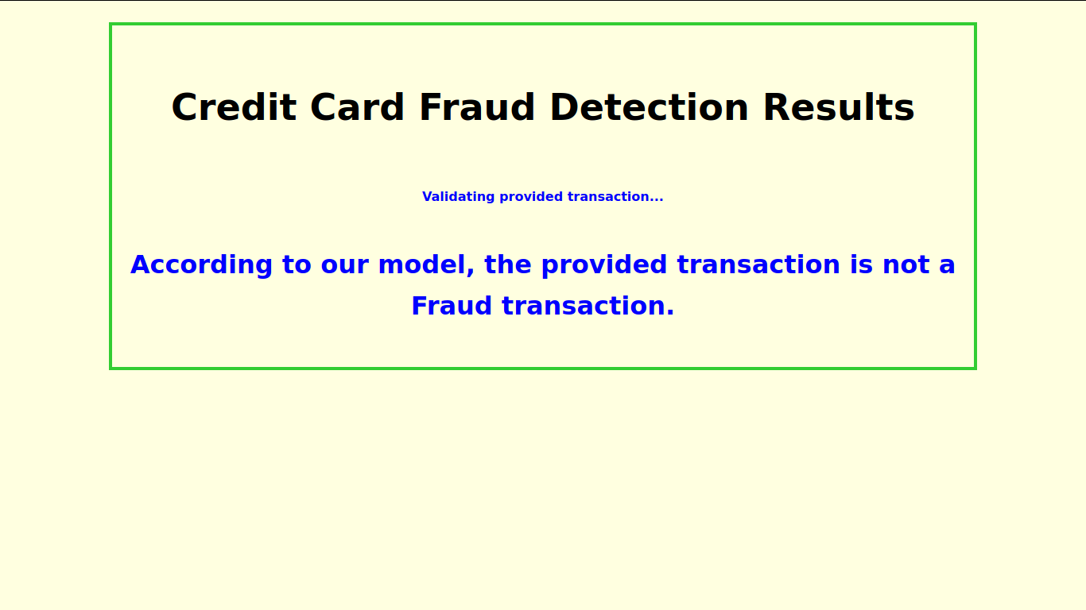

Slide 19
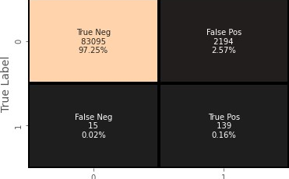
Results
The code prints out the number of false positives it detected and compares it with the actual values. This is used to calculate the accuracy score and precision of the algorithms. The fraction of data we used for faster testing is 10% of the entire dataset. The complete dataset is also used at the end and both the results are printed.
These results along with the classification report for each algorithm is given in the output as follows, where class 0 means the transaction was determined to be valid and 1 means it was determined as a fraud transaction. This result matched against the class values to check for false positives.
Our classifier accuracy came out to be 97.4%
This idea is difficult to implement in real life because it requires the cooperation from banks, which aren’t willing to share information due to their market competition, and also due to legal reasons and protection of data of their users.

Slide 20
Conclusion
Credit Card is a great tool to pay money easily, but as with all the other monetary payment tools, reliability is a issue here too as it is subjected to breach and other frauds. To encounter this problem, a solution is needed to identify the patterns in the transactions and identify the ones which are fraud, so that finding such transactions beforehand in future will be very easy.
Machine Learning is a great tool to do this work since Machine Learning helps us in finding patterns in the data. Machine Learning can help producing great results if provided enough amount of data. Also, with further advances in the technology, Machine Learning too will advance with time, it will be easy for a person to predict if a transaction is fraud or not much more accurately with the advances.

Slide 21
Future Scope
The software has been developed in such a way that it can accept modifications and further changes. The software is very user friendly and future any changes can be done easily. Software restructuring is carried out. Software restructuring modifies source code in an effort to make it amenable to future changes.
In general, restructuring does not modify the overall program architecture. It tends to focus on the design details of individual modules and on local data structure defined within modules. Every system should allow scope for further development or enhancement.
The system can be adapted for any further development. The system is so flexible to allow any modification need for the further functioning of programs. Since the objectives may not be brought broad in future, the system can be easily modified accordingly, as the system has been modularized. The future expansion can be done in a concise manner in order to improve the efficiently of the system.
While we couldn’t reach out goal of 100% accuracy in fraud detection, we did end up creating a system that can, with enough time and data, get very close to that goal. As with any such project, there is some room for improvement here.
The very nature of this project allows for multiple algorithms to be integrated together as modules and their results can be combined to increase the accuracy of the result. This model can further be improved with the addition of more algorithms into it. However, the output of these algorithms needs to be in the same format as the others.
Once that condition is satisfied, the modules are easy to add as done in the code. This provides a great degree of modularity and versatility to the project.
More room for improvement can be found in the dataset. As demonstrated before, the precision of the algorithms increases when the size of dataset is increased. Hence, more data will surely make the model more accurate in detecting frauds and reduce the number of false positives. However, this requires official support from the banks themselves.

